Slide 1

State of the Shell
April 2023
Notes:
Presenters – Steve Lee, Steven Bucher, Jason Helmick, Sydney Smith (Danny if needed)
Ice breaker questions:
First time at the conference? Been more than 1-3? How many people
How far are people traveling
Other presentations:
SSH
Crescendo
Shell enlightenments
DSCv3

Slide 2




PowerShell
One Microsoft Way
November 2004

Slide 3
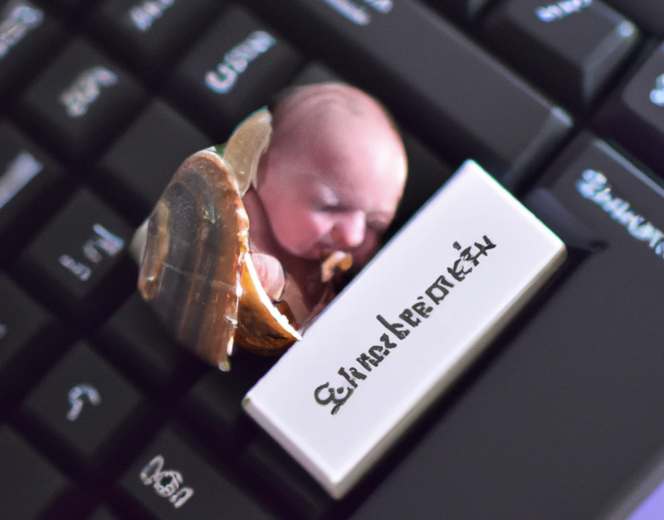

Slide 4



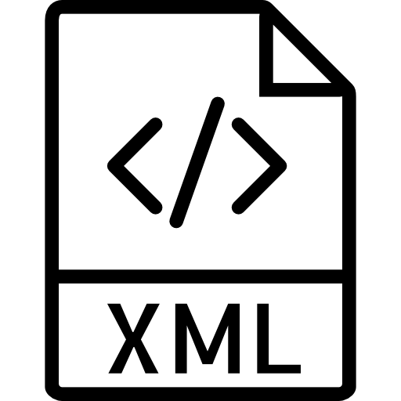












Notes:
16 years ago the world was a messy place, and 16 years ago I was 8 years old. and you may think I had no idea how messy of a world it was at that point but trust me I did, <Pic> it was SO messy that they put me to work in datacenters trying to clean up the mess. (Now don't worry this picture was from long before PowerShell was created)
COM, XML, Netowrking, Win32, VSC, Storage, WMI/CIM, hyper V, files, etc

Slide 5

Notes:
16 years ago the world was a messy place
Along came Windows PowerShell
Cmdlets for consistency, added value, discoverability, ease of use
Syntax suitable for both scripting and interactive shell use

Slide 6
16 years ago the world was a messy place
Networking
Registry
COM
XML
Win32
Security
Identity
CSV
JSON
.NET
Files
Storage
WinRM Remoting
Hyper-V
WMI/CIM

Slide 7
designed on the tenants
Security
Testability
Supportability
Consistency
Scalability
Discoverability
Extensibility
Reliability

Slide 8




“Learn PowerShell and we’ll do everything we can to make it the best investment you’ve ever made.” – Jeffrey Snover
Notes:
PowerShell provided the toolset but it alone didn’t solve the problems
We empowered you, and you took the toolset into the real world and solved
Real challenges
But the story didn’t end there because of the sacred vow,
So we kept working on expanding the toolkit to make you more valuable

Slide 9

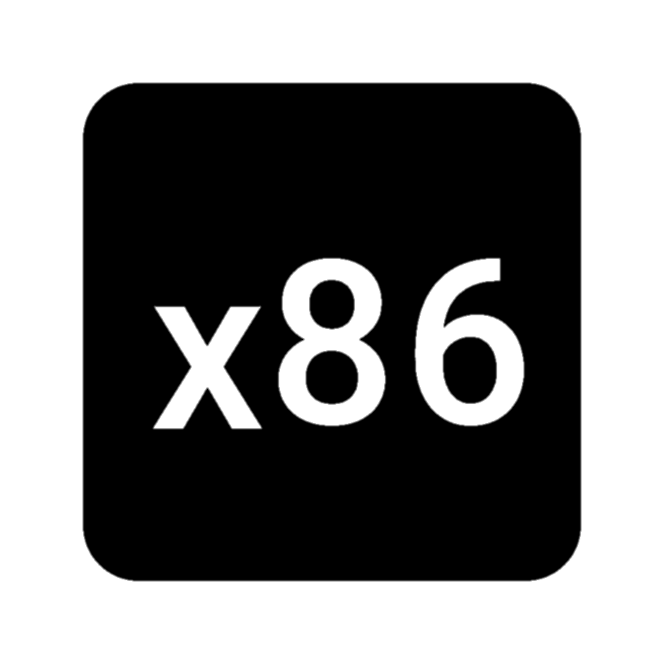
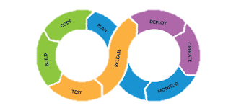





















.tgz
.msi
.msix
.rpm
.deb
Notes:
Then the world got messier…

Slide 10

.tgz
.deb
.msix
.rpm
.msi
Notes:
Then the world got messier…
Along came PowerShell 7

Slide 11
Despite the changing world, the tenants of PowerShell remained the same
Security
Testability
Supportability
Consistency
Scalability
Discoverability
Extensibility
Reliability

Slide 12
“Learn PowerShell and we’ll do everything we can to make it the best investment you’ve ever made.” – Jeffrey Snover
Notes:
PowerShell provided the toolset but it alone didn’t solve the problems
We empowered you, and you took the toolset into the real world and solved
Real challenges
But the story didn’t end there because of the sacred vow,
So we kept working on expanding the toolkit to make you more valuable

Slide 13





.tgz
.msi
Notes:
We are now entering a new phase where the world has once again gotten messier
Disruptive technologies have shown to create more messy before it really gets cleaned up.
Incorportate it into your world
So we are bringing
Increase success
Increase learning
Increase discoverability
We think A.I is the avenue of technology that can really help accelerate

Slide 14

.tgz
.msi

Slide 15
What we’ve been up to
Open SSH 9.1
Open SSH 9.2
Improve suggestion framework and make it pluggable
Mariner arm64 AzPS container
VSCode Configurability for CodeLens and History
Shell Integration
VSCode symbols fixes
VSCode debugger fixes
Local Session Configuration
Custom ConectionInfo
Improve AMSI support
Improve WDAC support
PSReadLine improvements
Predictor list scrolling
Feedback provider
PowerShellGet 3.0 previews
Get-WhatsNew
NativeArgPassing
PSES support for non-VSCode integrations
JSON Adapter RFC
Telemetry Improvements
All new Azure services have a command line tool within 30 days of GA
Support for Web Authentication Manager (also known as Windows broker) by Azure CLI and Azure PowerShell
Refreshed 9 Azure PowerShell module to using a newer API version
Implemented live test on each release for 80+ critical Azure scenarios
Maintained 72h SLA on GitHub issues responses
Exposed Azure command line tools in Azure Portal for 14 resources types for PowerShell
Reduced Azure CLI footprint on Windows by 30%

Slide 16
Commitment to Improving PowerShell
Update to use ComputeCore.dll for PowerShell Direct (#18194)
Replace ArgumentNullException(nameof()) with ArgumentNullException.ThrowIfNull() (#18792)(#18784) (Thanks @CarloToso!)
Remove TabExpansion from remote session configuration (#18795) (Internal 23331)
WebCmdlets get Retry-After from headers if status code is 429 (#18717) (Thanks @CarloToso!)
Implement SupportsShouldProcess in Stop-Transcript (#18731) (Thanks @JohnLBevan!)
Fix New-Item -ItemType Hardlink to resolve target to absolute path and not allow link to itself (#18634)
Add output types to Format commands (#18746) (Thanks @MartinGC94!)
Fix the process CommandLine on Linux (#18710) (Thanks @jborean93!)
Fix SuspiciousContentChecker.Match to detect a pre-defined string when the text starts with it (#18693)
Switch $PSNativeCommandUseErrorActionPreference to $true when feature is enabled (#18695)
Fix Start-Job to check the existence of working directory using the PowerShell way (#18675)
Webcmdlets add 308 to redirect codes and small cleanup (#18536) (Thanks @CarloToso!)
Ensure HelpInfo.Category is consistently a string (#18254)
Remove gcloud from the legacy list because it's resolved to a .ps1 script (#18575)
Add gcloud and sqlcmd to list to use legacy argument passing (#18559)
Fix native access violation (#18545) (#18547) (Thanks @chrullrich!)
Fix issue when completing the first command in a script with an empty array expression (#18355) (Thanks @MartinGC94!)
Improve type inference of hashtable keys (#17907) (Thanks @MartinGC94!)
Fix Switch-Process to copy the current env to the new process (#18452)
Fix Switch-Process error to include the command that is not found (#18443)
Update Out-Printer to remove all decorating ANSI escape sequences from PowerShell formatting (#18425)
Web cmdlets set default charset encoding to UTF8 (#18219) (Thanks @CarloToso!)
Fix incorrect cmdlet name in the script used by Restart-Computer (#18374) (Thanks @urizen-source!)
Add the function cd~ (#18308) (Thanks @GigaScratch!)
Fix type inference error for empty return statements (#18351) (Thanks @MartinGC94!)
Fix the exception reporting in ConvertFrom-StringData (#18336) (Thanks @GigaScratch!)
Implement IDisposable in NamedPipeClient (#18341) (Thanks @xtqqczze!)
Replace command-error suggestion with new implementation based on subsystem plugin (#18252)
Remove the ProcessorArchitecture portion from the full name as it's obsolete (#18320)
Make the fuzzy searching flexible by passing in the fuzzy matcher (#18270)
Add -FuzzyMinimumDistance parameter to Get-Command (#18261)
Improve startup time by triggering initialization of additional types on background thread (#18195)
Fix decompression in web cmdlets (#17955) (Thanks @iSazonov!)
Add CustomTableHeaderLabel formatting to differentiate table header labels that are not property names (#17346)
Remove the extra new line form List formatting (#18185)
Minor update to the FileInfo table formatting on Unix to make it more concise (#18183)
Fix Parent property on processes with complex name (#17545) (Thanks @jborean93!)
Make PowerShell class not affiliate with Runspace when declaring the NoRunspaceAffinity attribute (#18138)
Complete the progress bar rendering in Invoke-WebRequest when downloading is complete or cancelled (#18130)
Display download progress in human readable format for Invoke-WebRequest (#14611) (Thanks @bergmeister!)
Update WriteConsole to not use stackalloc for buffer with too large size (#18084)
Filter out compiler generated types for Add-Type -PassThru (#18095)
Fixing CA2014 warnings and removing the warning suppression (#17982) (Thanks @creative-cloud!)
Make experimental feature PSNativeCommandArgumentPassing stable (#18044)
Make experimental feature PSAMSIMethodInvocationLogging stable (#18041)
Handle PSObject argument specially in method invocation logging (#18060)
Fix typos in EventResource.resx (#18063) (Thanks @eltociear!)
Make experimental feature PSRemotingSSHTransportErrorHandling stable (#18046)
Make experimental feature PSExec stable (#18045)
Make experimental feature PSCleanBlock stable (#18043)
Fix error formatting to use color defined in $PSStyle.Formatting (#17987)
Remove unneeded use of chmod 777 (#17974)
Support mapping foreground/background ConsoleColor values to VT escape sequences (#17938)
Make pwsh server modes implicitly not show banner (#17921)
Add output type attributes for Get-WinEvent (#17948) (Thanks @MartinGC94!)
Remove 1 second minimum delay in Invoke-WebRequest for small files, and prevent file-download-error suppression. (#17896) (Thanks @AAATechGuy!)
Add completion for values in comparisons when comparing Enums (#17654) (Thanks @MartinGC94!)
Fix positional argument completion (#17796) (Thanks @MartinGC94!)
Fix member completion in attribute argument (#17902) (Thanks @MartinGC94!)
Throw when too many parameter sets are defined (#17881) (Thanks @fflaten!)
Limit searching of charset attribute in meta tag for HTML to first 1024 characters in webcmdlets (#17813)
Fix Update-Help failing silently with implicit non-US culture. (#17780) (Thanks @dkaszews!)
Add the ValidateNotNullOrWhiteSpace attribute (#17191) (Thanks @wmentha!)
Improve enumeration of inferred types in pipeline (#17799) (Thanks @MartinGC94!)
Fix SuspiciousContentChecker.Match to detect a pre-defined string when the text starts with it (#18916)
Fix for JEA session leaking functions (Internal 23820)
Fix Start-Job to check the existence of working directory using the PowerShell way (#18917)
Fix Switch-Process error to include the command that is not found (#18650)
Allow system lock down test debug hook to work with new WLDP API (fixes system lock down tests) (#18962)
Update dependencies for .NET release (Internal 23818)
Remove unnecessary reference to System.Runtime.CompilerServices.Unsafe (#18918)
Add bootstrap after SBOM task to re-install .NET (#18891)
Fix completion for PSCustomObject variable properties (#18682) (Thanks @MartinGC94!)
Improve type inference for Get-Random (#18972) (Thanks @MartinGC94!)
Make -Encoding parameter able to take ANSI encoding in PowerShell (#19298) (Thanks @CarloToso!)
Telemetry improvements for tracking experimental feature opt out (#18762)
Support HTTP persistent connections in Web Cmdlets (#19249) (Thanks @stevenebutler!)
Fix using xml -Body in webcmdlets without an encoding (#19281) (Thanks @CarloToso!)
Add the Statement property to $MyInvocation (#19027) (Thanks @IISResetMe!)
Fix Start-Process -Wait with -Credential (#19096) (Thanks @jborean93!)
Adjust PUT method behavior to POST one for default content type in WebCmdlets (#19152) (Thanks @CarloToso!)
Improve verbose message in web cmdlets when content length is unknown (#19252) (Thanks @CarloToso!)
Preserve WebSession.MaximumRedirection from changes (#19190) (Thanks @CarloToso!)
Take into account ContentType from Headers in WebCmdlets (#19227) (Thanks @CarloToso!)
Use C# 11 UTF-8 string literals (#19243) (Thanks @turbedi!)
Add property assignment completion for enums (#19178) (Thanks @MartinGC94!)
Fix class member completion for classes with base types (#19179) (Thanks @MartinGC94!)
Add -Path and -LiteralPath parameters to Test-Json cmdlet (#19042) (Thanks @ArmaanMcleod!)
Allow to preserve the original HTTP method by adding -PreserveHttpMethodOnRedirect to Web cmdlets (#18894) (Thanks @CarloToso!)
Webcmdlets display an error on https to http redirect (#18595) (Thanks @CarloToso!)
Build the relative URI for links from the response in Invoke-WebRequest (#19092) (Thanks @CarloToso!)
Fix redirection for -CustomMethod POST in WebCmdlets (#19111) (Thanks @CarloToso!)
Dispose previous response in Webcmdlets (#19117) (Thanks @CarloToso!)
Improve Invoke-WebRequest xml and json errors format (#18837) (Thanks @CarloToso!)
Fix error formatting to remove the unneeded leading newline for concise view (#19080)
Add -NoHeader parameter to ConvertTo-Csv and Export-Csv cmdlets (#19108) (Thanks @ArmaanMcleod!)
Fix Start-Process -Credential -Wait to work on Windows (#19082)
Add ValidateNotNullOrEmpty to OutFile and InFile parameters of WebCmdlets (#19044) (Thanks @CarloToso!)
Correct spelling of "custom" in event (#19059) (Thanks @spaette!)
Ignore expected error for file systems not supporting alternate streams (#19065)
Adding missing guard for telemetry opt out to avoid NullReferenceException when importing modules (#18949) (Thanks @powercode!)
Fix progress calculation divide by zero in Copy-Item (#19038)
Add progress to Copy-Item (#18735)
WebCmdlets parse XML declaration to get encoding value, if present. (#18748) (Thanks @CarloToso!)
HttpKnownHeaderNames update headers list (#18947) (Thanks @CarloToso!)
Fix bug with managing redirection and KeepAuthorization in Web cmdlets (#18902) (Thanks @CarloToso!)
Fix Get-Error to work with strict mode (#18895)
Add AllowInsecureRedirect switch to Web cmdlets (#18546) (Thanks @CarloToso!)
Invoke-RestMethod -FollowRelLink fix links containing commas (#18829) (Thanks @CarloToso!)
Prioritize the default parameter set when completing positional arguments (#18755) (Thanks @MartinGC94!)
Add -CommandWithArgs parameter to pwsh (#18726)
Enable creating composite subsystem implementation in modules (#18888)
Fix Format-Table -RepeatHeader for property derived tables (#18870)
Add StatusCode to HttpResponseException (#18842) (Thanks @CarloToso!)
Fix type inference for all scope variables (#18758) (Thanks @MartinGC94!)
Add completion for Using keywords (#16514) (Thanks @MartinGC94!)
Add Instrumentation to AmsiUtil and make the init variable readonly (#18727)
Fix typo in OutOfProcTransportManager.cs (#18766) (Thanks @eltociear!)
Allow non-default encodings to be used in user's script/code (#18605)
Add Dim and DimOff to $PSStyle (#18653)
Change exec from alias to function to handle arbitrary arguments (#18567)
The command prefix should also be in the error color for NormalView (#18555)
Skip cloud files marked as "not on disk" during command discovery (#18152)
Replace UTF8Encoding(false) with Encoding.Default (#18356) (Thanks @xtqqczze!)
Fix Switch-Process to set termios appropriate for child process (#18467)
On Unix, only explicitly terminate the native process if not in background (#18215)
Treat [NullString]::Value as the string type when resolving methods (#18080)
Improve pseudo binding for dynamic parameters (#18030) (Thanks @MartinGC94!)
Make experimental feature PSAnsiRenderingFileInfo stable (#18042)
Update to use version 2.21.0 of Application Insights. (#17903)
Do not preserve temporary results when no need to do so (#17856)
Fixed package names verification to support multi-digit versions (#17220)
Add pipeline secrets (from #17837) (Internal 24413)
Update to azCopy 10 (#18509)
Update third party notices for v7.2.10 (Internal 24346)
Update cgmanifest for v7.2.10 (Internal 24333)
Pull latest patches for 7.2.10 dependencies (Internal 24325)
Update SDK to 6.0.406 for v7.2.10 (Internal 24324)
Add test for framework dependent package in release pipeline (#18506) (#19114)
Mark 7.2.x releases as latest LTS but not latest stable (#19069)
Update third party notices for v7.3.3 (Internal 24353)
Add tool to trigger license information gathering for NuGet modules (#18827)
Update global.json to 7.0.200 for v7.3.3 (Internal 24334)
Update cgmanifest for v7.3.3 (Internal 24338)
Remove TabExpansion for PSv2 from remote session configuration (Internal 23331)
Add sqlcmd to list to use legacy argument passing (#18645 #18646)
Change exec from alias to function to handle arbitrary args (#18644)
Fix Switch-Process to copy the current env to the new process (#18632)
Fix issue when completing the first command in a script with an empty array expression (#18355)
Fix Switch-Process to set termios appropriate for child process (#18572)
Fix native access violation (#18571)
Update packages (Internal 23330)
Apply expected file permissions to linux files after authenticode signing (#18647)
Bump System.Data.SqlClient (#18573)
Don't install based on build-id for RPM (#18570)
Work around args parsing issue (#18607)
Fix package download in vPack job
27 different releases since April 27
8 of which are preview releases
Engine Updates and Fixes
On Unix, explicitly terminate the native process during cleanup only if it's not running in background (#18280)
Stop sending telemetry about ApplicationType (#18168)
General Cmdlet Updates and Fixes
Remove the 1-second minimum delay in Invoke-WebRequest for downloading small files, and prevent file-download-error suppression (#18170)
Enable searching for assemblies in GAC_Arm64 on Windows (#18169)
Fix error formatting to use color defined in $PSStyle.Formatting (#18287)
Update CGManifest and ThirdPartyNotices
Update Microsoft.CSharp from 4.3.0 to 4.7.0
Update to latest SDK (#18610)
Allow two-digit revisions in vPack package validation pattern (#18569)
Update outdated dependencies (#18576)
Work around args parsing issue (#18606)
Bump System.Data.SqlClient from 4.8.4 to 4.8.5 (#18515)
Update some PowerShell APIs to throw ArgumentException instead of ArgumentNullException when the argument is an empty string (#19215) (Thanks @xtqqczze!)
Add the parameter -ProgressAction to the common parameters (#18887)
Fix PlainText output to correctly remove the Reset VT sequence without number (#19283)
Fix ConciseView to handle custom ParserError error records (#19239)
Fix VtSubstring helper method to correctly check characters copied (#19240)
Update the FeedbackProvider interface to return structured data (#19133)
Make the exception error in PowerShell able to associate with the right history entry (#19095)
Fix for JEA session leaking functions (#19024)
Add WDAC events and system lockdown notification (#18893)
Fix support for nanoserver due to lack of AMSI (#18882)
Fix Start-Job to check the existence of working directory using the PowerShell way (#18917)
Fix Switch-Process error to include the command that is not found (#18650)
Add instrumentation to AmsiUtil and make the init variable readonly (#18727)
Fix support for NanoServer due to the lack of AMSI (#18882)
Adding missing guard for telemetry optout to avoid NullReferenceException when importing modules (#18949) (Thanks @powercode!)
Fix VtSubstring helper method to correctly check chars copied (#19240)
Fix ConciseView to handle custom ParserError error records (#19239)
Create test artifacts for windows arm64 (#18932)
Update dependencies for .NET release (Internal 23816)
Don't install based on build-id for RPM (#18921)
Apply expected file permissions to linux files after authenticode signing (#18922)
Add authenticode signing for assemblies on linux builds (#18920)
Add instrumentation to AmsiUtil and make the init variable readonly (#18727)
Fix support for NanoServer due to the lack of AMSI (#18882)
Adding missing guard for telemetry optout to avoid NullReferenceException when importing modules (#18949) (Thanks @powercode!)
Fix VtSubstring helper method to correctly check chars copied (#19240)
Fix ConciseView to handle custom ParserError error records (#19239)
Fix issues with building test artifacts (Internal 23116)
Use AzFileCopy task instead of AzCopy.exe
Remove AzCopy installation from msixbundle step
Add TSAUpload for APIScan (#18446)
Add authenticode signing for assemblies on Linux builds (#18440)
Do not remove penimc_cor3.dll from build (#18438)
Allow two-digit revisions in vPack package validation pattern (#18392)
Bump Microsoft.PowerShell.Native from 7.3.0-rc.1 to 7.3.0 (#18413)
Notes:
And that’s not all, since last April we have done 27 different release of PowerShell which 8 of which have been preview releases. Here is just a taste of the different changes that have come from each release.
Since we don’t have much time I figured I could just start reading off all of these items? That okay with you guys?
No no I am just kidding but the main take aways I want to leave you with this slide is that we (and our amazing community) have been working very hard to continue to improve PowerShell.
We also want to emphasis our commitment to security, and our investments into new features to increase security through logging and remoting.

Slide 17






Better together
=

Slide 18
Demo Time
Notes:
Theme
Demo
Person
Notes
The Terminal is Cool again
Windows Terminal
Sydney
The Terminal is Cool again
VSCode Terminal (Shell integration?)
Sydney
The Terminal is Cool again
Cloud Shell
Jason
The Terminal is Cool again
VT/ANSI escape sequences/$PSStyle
Steve
The Terminal is Cool again
Native commands in use: git, kubectl, docker, etc.
Steve
The Terminal is Cool again
Intro to crescendo
Jason
Security First
Microsoft Update
Steven
Security First
WDAC
Steve
Security First
AMSI
Steve
Security First
Logging
Sydney
Security First
SecretMangement/Secret Store
Sydney
Native Commands
$PSNativeCommandUseErrorActionPreference
Steve
Native Commands
$PSNativeCommandArgumentPassing
Jason
Native Commands
Native pipe between commands
Steven
Native Commands
Progression of convert-fromJSON, JC, and future looking for JSON adapters
Steven
What’s New
Get-WhatsNew
Jason
Help when something goes wrong
Get-Error
Sydney
Help when something goes wrong
Feedback Provider
Steven
Interactive Help
Predictors
Steven
Interactive Help
PSReadLine
Jason
Interactive Help
Natural Language (CoPilot, Codex, ChatGPT)
Steve

Slide 19
What you’ve been up to…
Notes:
So enough about us, what have you, the community been up to??
Well let me tell you, PowerShell users have been BUSY!

Slide 20
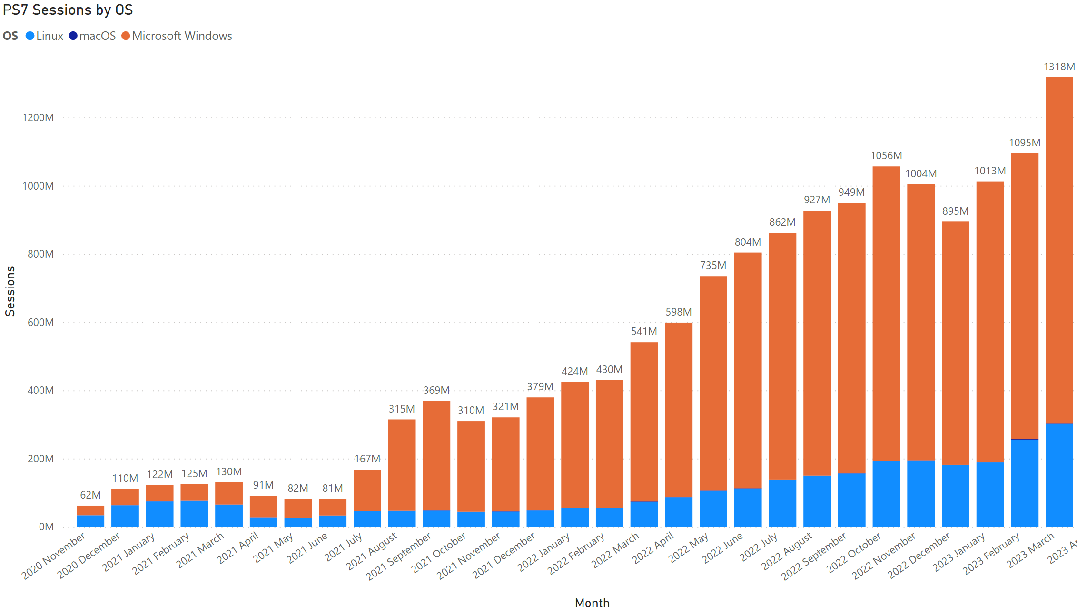
Summit 2023 -
1.3+ BILLION
Summit 2022 -
598M
Notes:
So this is the number of PowerShell Session since we first started collecting it in 2020, and we had HUGE groth to start with. August 2021 session count just started exploding and kept growing and growing. Last summit we were at nearly 600M PowerShell Sessions for the month of April.
Well guess what, it didn’t stop there. It kept GROWING and GROWING this year, so much so that we hit our first BILLION PowerShell sessions in October of 2022. and it still didn’t stop there, last month, march 2023 we had 1.3BILLION PowerShell sessions!! This is just remarkable. In little over two years PowerShell has 7 has

Slide 21
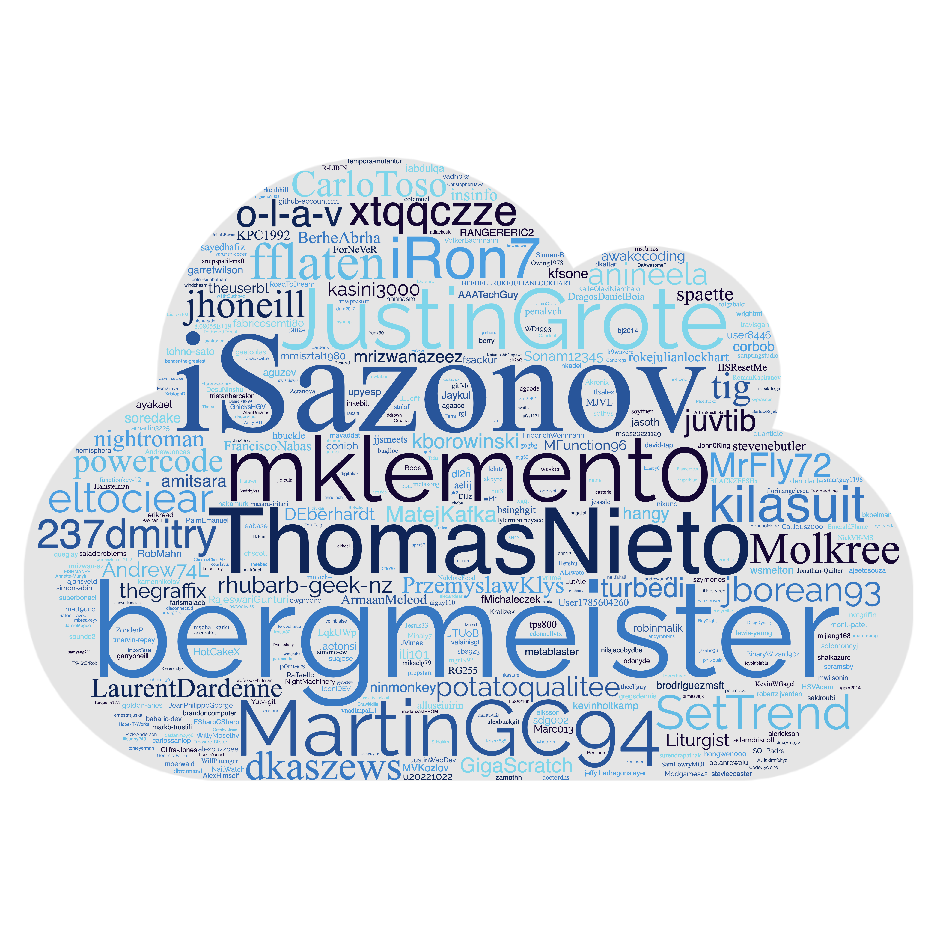

Notes:
Have people raise a hand if you have contributed to the PowerShell repo? R
Over 3,000 PRs created in the last year, of which ~2900 were closed
Similar over 2284 issues were created
Take away the msft

Slide 22
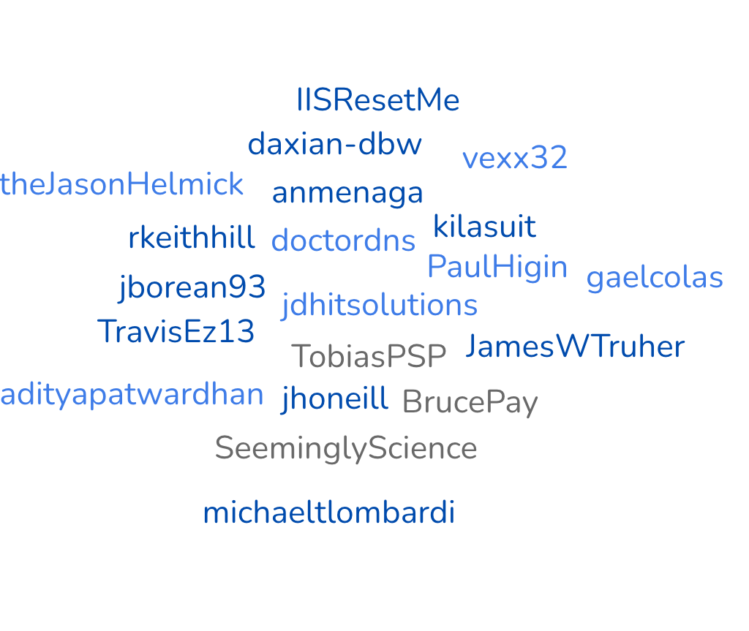
Working Group Members
SteveL-MSFT
Notes:
@jdhitsolutions
@TobiasPSP
@doctordns
@jhoneill
@anmenaga
@jborean93
@PaulHigin
@TravisEz13
@BrucePay
@SeeminglyScience
@daxian-dbw
@adityapatwardhan
@JamesWTruher
@SeeminglyScience
@kilasuit
@BrucePay
@rkeithhill
@vexx32
@IISResetMe
@theJasonHelmick
@gaelcolas
@michaeltlombardi
ADD STEVE AND SYDNEY

Slide 23

PowerShell Gallery
11,000 unique packages
200,000 total packages
300 million monthly downloads
8 billion total downloads

Slide 24
WINDOWS OpenSSH usage data
Over 4 million total GitHub downloads!
54K of latest version (v9.2.0.0p1-beta) release Feb 2023

Slide 25
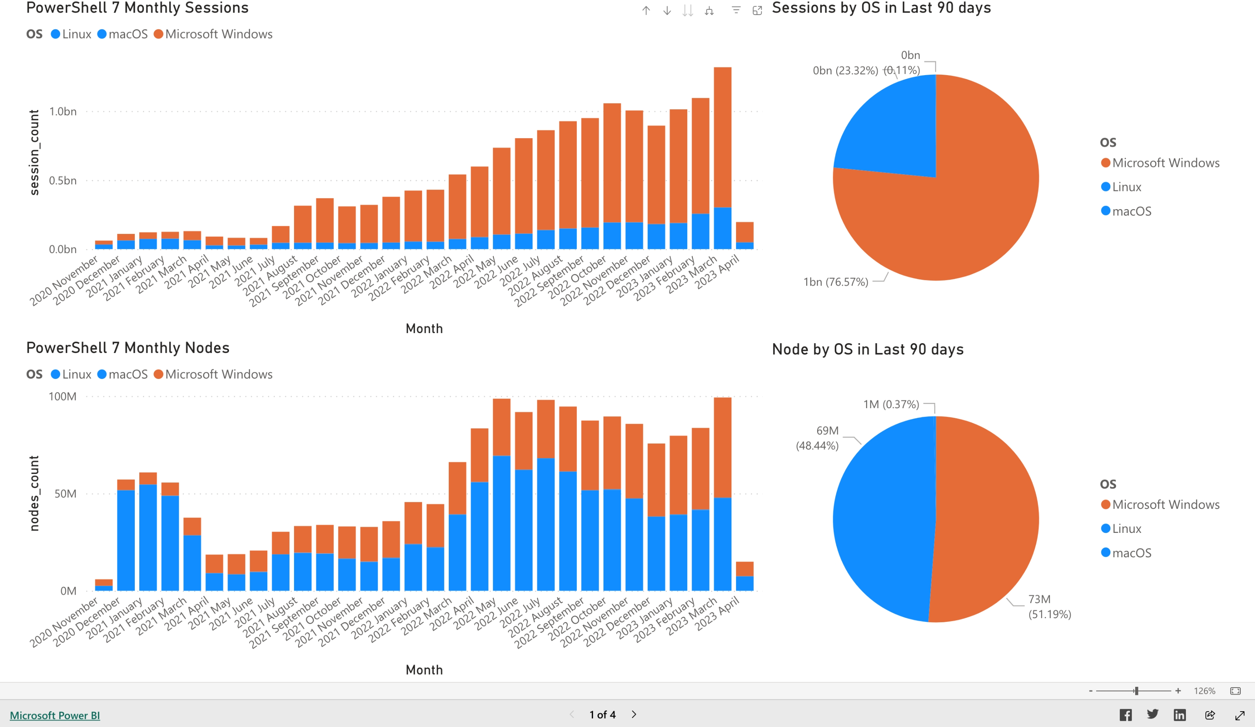
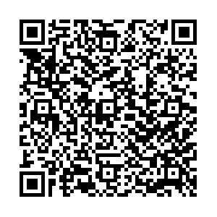
Public Dashboard Announcement
Aka.ms/PSPublicDashboard
Notes:
Also a special announcement! We have now created a new and improved Public PowerShell dashboard that you can view and follow along with PowerShell’s growth! We have a lot of data about PowerShell session and node usage as well as some of the top community contributors and general contributions. If there is other data or suggestions you would like to see please feel free to submit an issue in our PowerShell repo and I am happy to see if we can improve this. Go check it out!

Slide 26
We’ll be here all week
Monday
2:00 - Improving Shell usability – DSC v3
3:15 - Shell Enhancement
Tuesday
1:00 – A year of improvements to your PS editing experience
Wednesday
11:00 – Remote evolving – SSH
1:00 – Improving shell usability – Crescendo
Thursday
10:00 – Contribute to Docs like a Microsoft Insider

Slide 27

Thank you
Enjoy the conference!
Get PowerShell: https://aka.ms/Get-PowerShell
Stay in Touch!
PowerShell GitHub
www.github.com/powershell
PS Community Call – 3rd Thursday of every month
www.aka.ms/joinPSCall
PowerShell Team Blog
https://devblogs.microsoft.com/powershell
PowerShell Team Twitter
https://twitter.com/PowerShell_Team

Slide 28
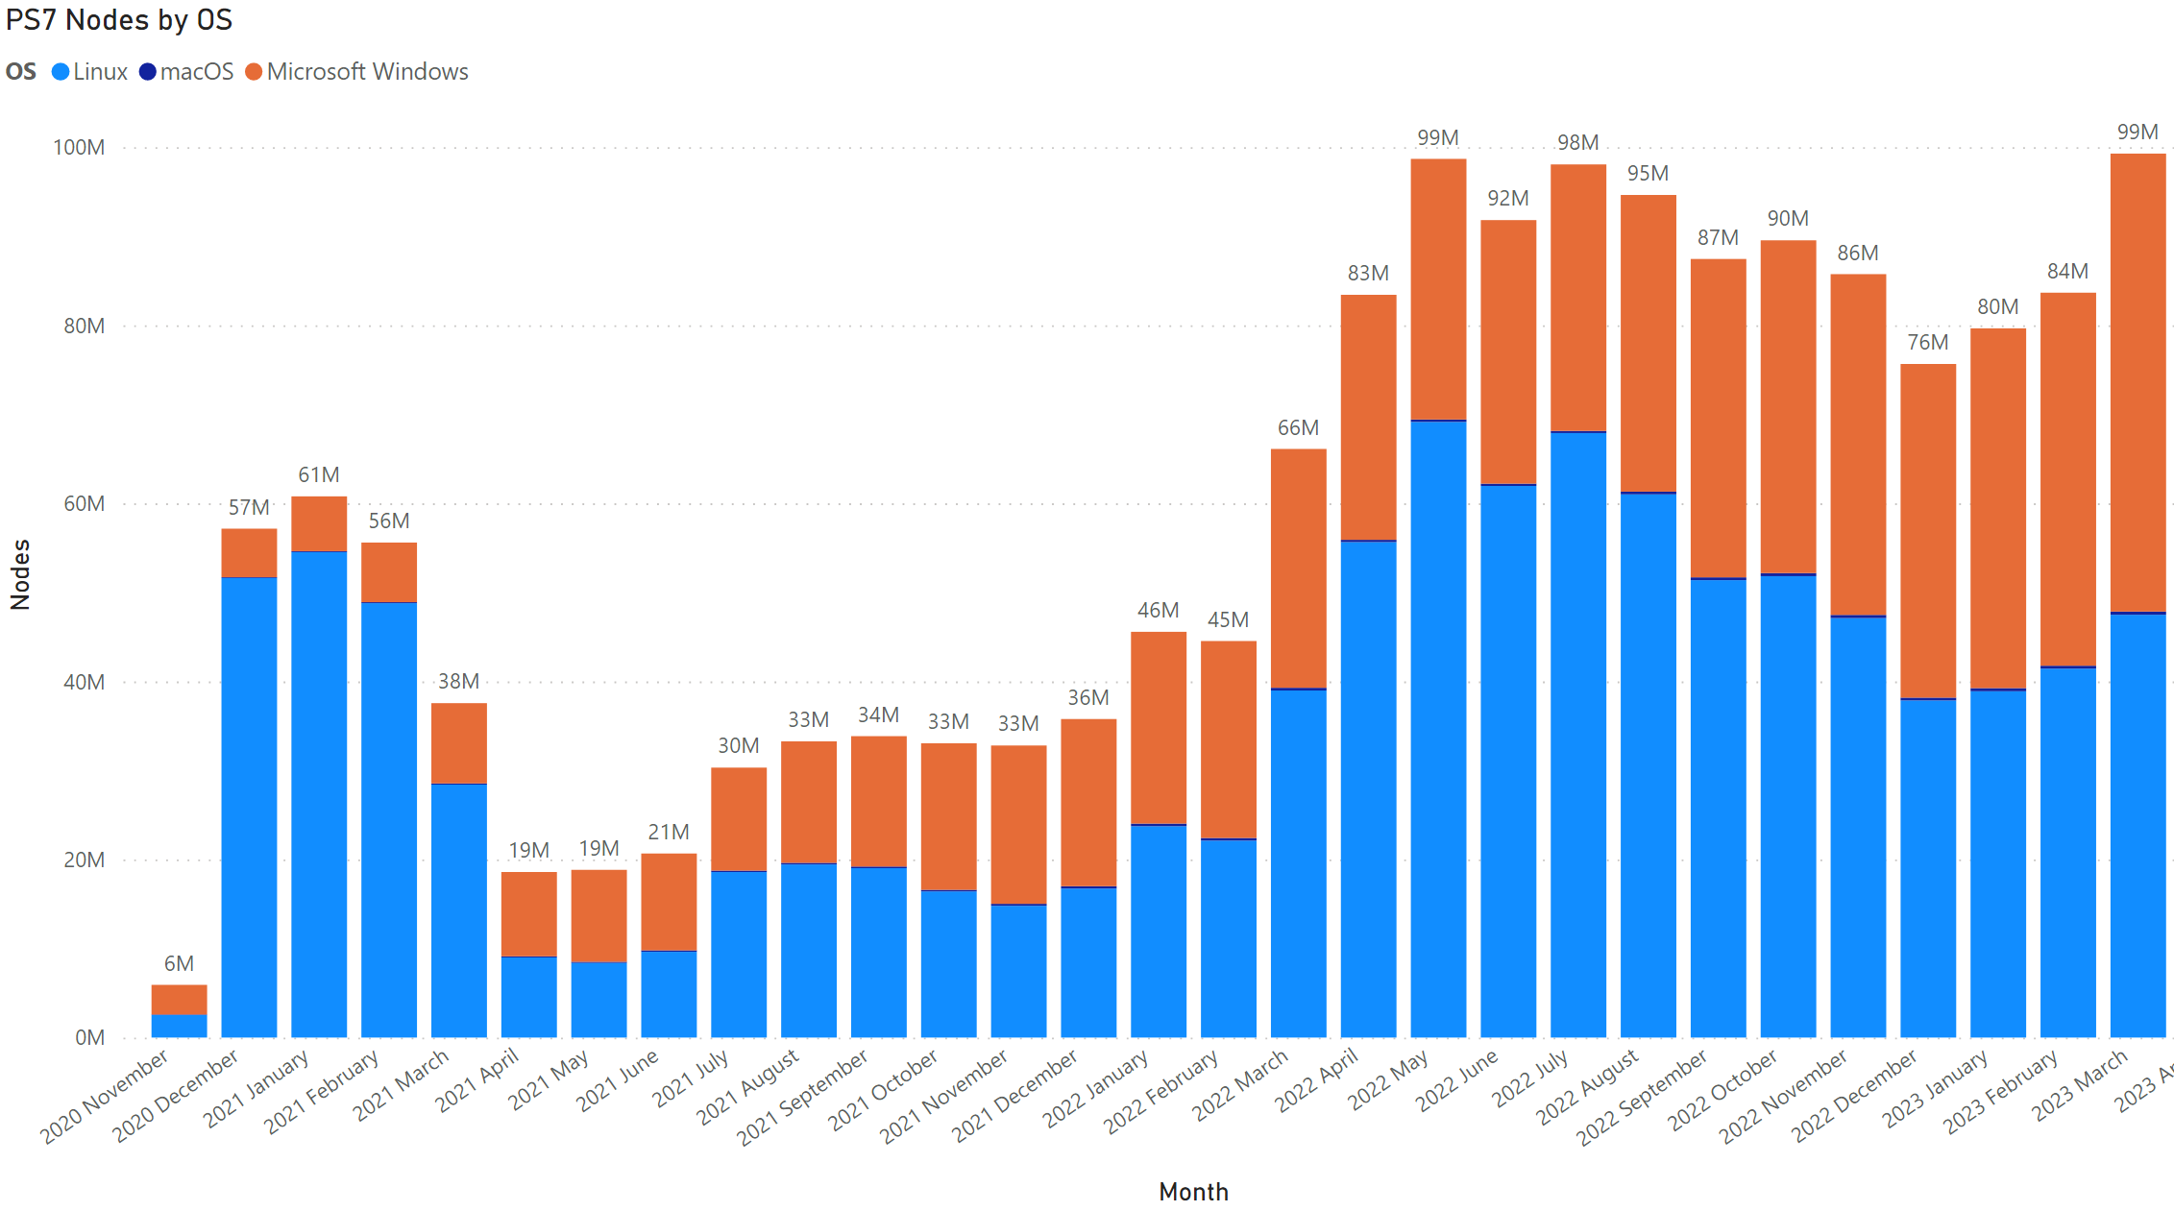

Slide 29
PowerShell
One Microsoft Way
November 2004

